Slide 1
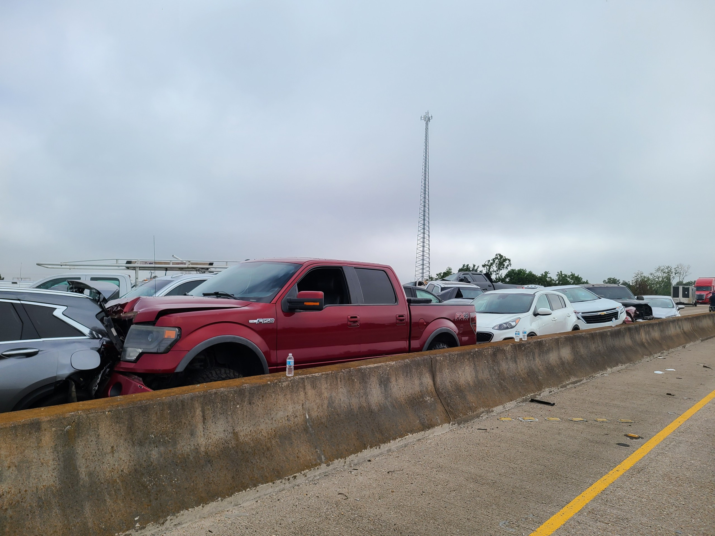

2024 LEMC PLENARY SESSION
LA I-55
SUPER FOG
INCIDENT
Multi-Agency Response involving partners at the local, parish and state level
October 23, 2023

Slide 2
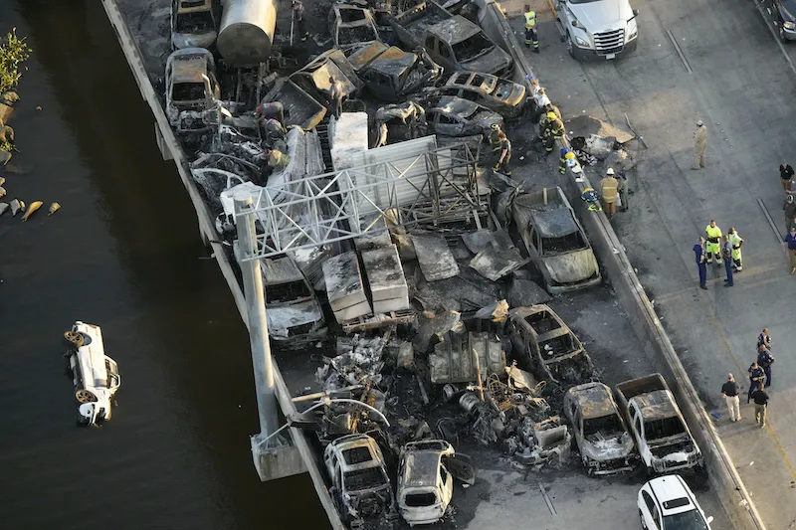
THE SCENE
An early morning in October was a harrowing scene of chaos and tragedy, unfolding amidst of the backdrop of a bustling interstate highway. Super Fog was the culprit has it combined fog conditions with smug from swamp wildfires, leading to a series a chain reaction of collisions with devastating consequences.
Responders worked tirelessly into cries of panic, shattered glass, tangled metal and wreckage to navigate life- saving efforts

Slide 3
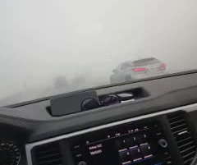
A MOTORIST’S PERSPECTIVE
Disclaimer - Profanity Warning
This Facebook video may contain explicit language and profanity. Viewer discretion is advised. The content presented in this video is intended for mature audiences. Viewer discretion is advised, especially for individuals sensitive to strong language

Slide 4
01
Information Sharing
Learn about initial notification, initial assessment of the scene, challenges and essential communication
02
Coordination & Collaboration
Specific actions, triage for life saving and investigation efforts, resources and response integration and efficiency
AGENDA
03
Needs & Priorities
Plenary session will be facilitated to generate insights from the panelists as well as accept audience comments for an immerse full conference discussion and learning experience.
Immediate issues, gaps and efforts to prioritize steps for effectiveness
04
Risk Assessment & Contingency Planning
Potential risks, challenges and problem solving those strategies
05
Recommendations Based on Real-Life Event
Share lesson learned to improve response and support responders and stakeholders better

Slide 5
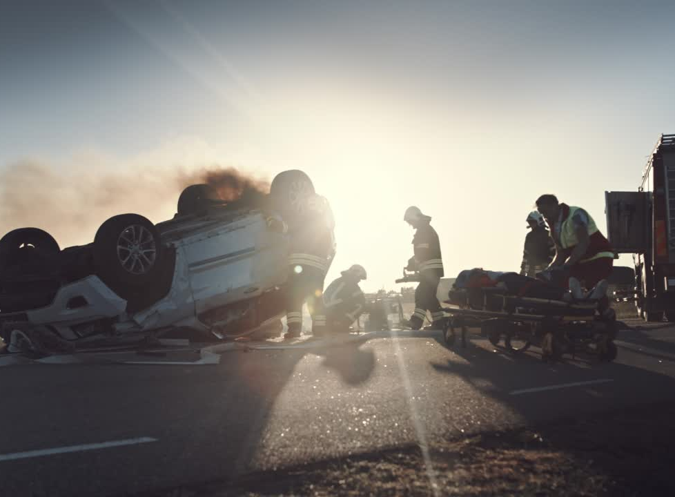
PLENARY PANELISTS
Core Group of Responders
Chief Daniel Folk, Hammond Fire
Lt. Monty Montelongo & Cpt. Joey Piglia, LA State Police
Colonel Travis Perrilloux, St. John OHSEP Director
Clint Blades, Acadian Ambalance
Chief Stormy Jonier, Ponchatoula Fire

Slide 6


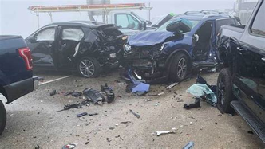
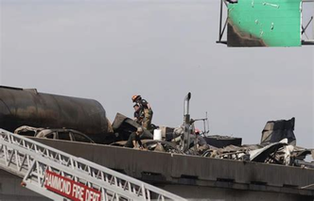
INFORMATION SHARING
Initial Notification
Initial Assessment
Challenges & Essential Communication

Slide 7
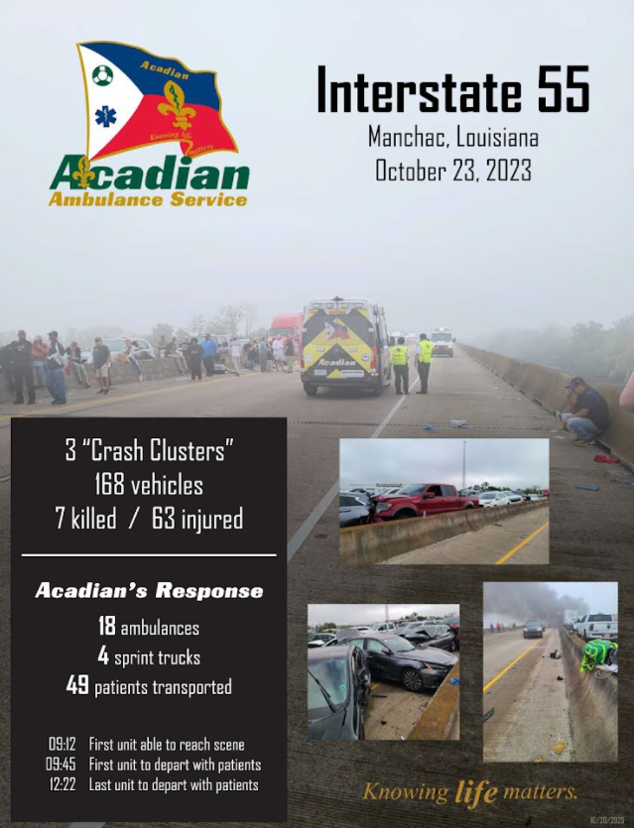

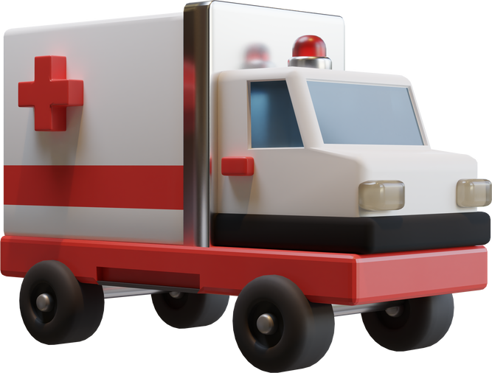

ACADIAN AMBULANCE SERVICE
Knowing LIFE Matters
Saving lives is the number one priority, and navigation through the cascade of wreckage and debris was significant
18
Ambulances
09:12
1st Unit on Scene
1st Unit to Depart
Last Unit to Depart
168
Vehicles
Sprint trucks
7
4
09:45
Killed
63
49
Injured
Patients Transported
12:22

Slide 8
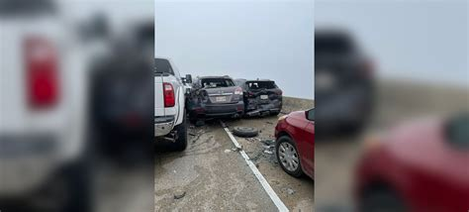
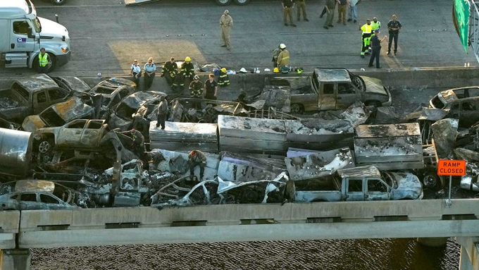
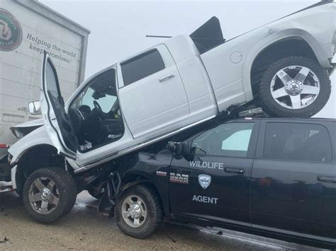
COORDINATION & COLLABORATION
About People
Organizations
Partnership
What resources do I need? Who do I need to help? What stakeholders are needed to contain, maintain and prevent?
What is needed the most and how to make those resources active?
What made the integration of partners successful?

Slide 9
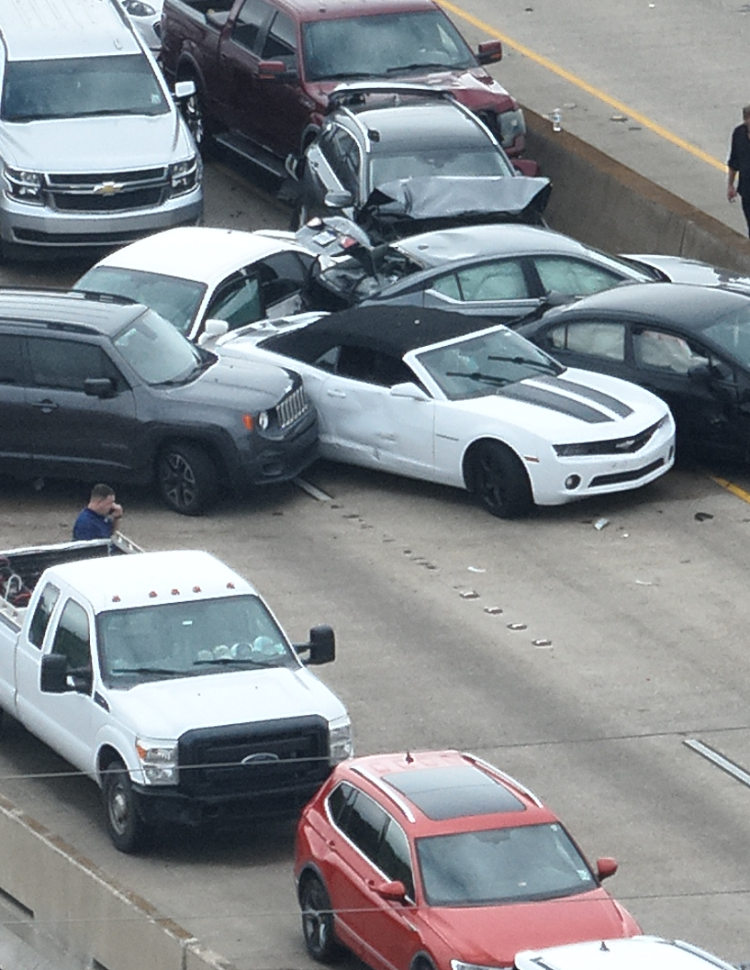
NEEDS & PRIORITIES
Dynamics continued to cascaded with multiple lives are at stake and triage of actions are essential of safety, containment, prevention and reunification
03
01
02
03
Triage
Prevention
Reunification

Slide 10
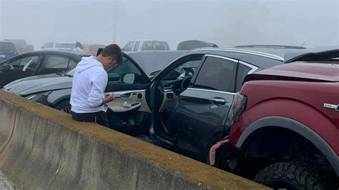
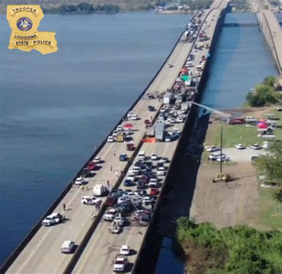
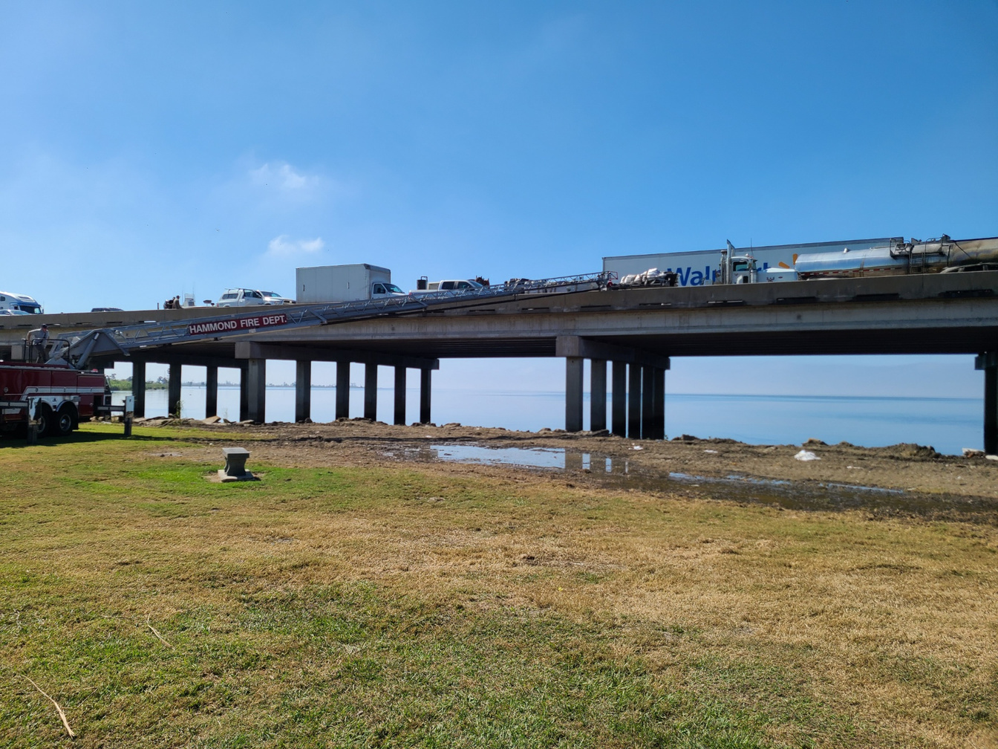
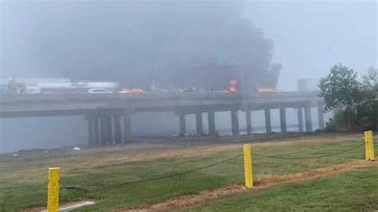

RISK ASSESSMENT
& CONTINGENCY PLANNING
Stuck and Non-Injured
Safely transition those in crash way to safe ground
Potential risks those stuck on interstate, those traveling that pathway - what were challenges and discuss the problem solving strategies to resolve those issues
Travelers heading that Directions
Communicating to divert traffic from the area
Flares Up
Containment of other hazards

Slide 11





LAW ENFORCEMENT
FIRE
RECOMMENDATIONS
Learning from Real-Life Events to improve prevention, preparedness, response, reocvery and mitigation
EMERGENCY
MANAGEMENT
HEALTH

Slide 12

TAKE-AWAYS
&
PARTICIPANT
ENGAGEMENT

